Slide 1
The Power of the Participant Perspective
Julie Brinker, MPA
Research Community Liaison
Clinical Translation Research Center

Slide 2
Objectives for this Presentation
What is a research participant advisory group?
What was the process for setting up a research participant advisory group at Children’s? And in the West End?
What are the similarities/differences between the two Children’s advisory councils?
What are some of the ways the Children’s advisory council has helped improve the research participant process?
What are the goals of the two advisory councils for the future?

Slide 3
What is a Research Participant Advisory Group?
Relatively new and innovative approach to informing what and how research is conducted
“…studies increasingly show that when health care administrators, providers, patients, and families work in partnership, the quality and safety of health care rise, costs decrease, and provider and patient satisfaction increase”
Willis, R., Krichten, A., Eldredge, K., & Carney, D. (2013). Creating a patient and family advisory council at a level 1 trauma center. Journal of Trauma Nursing, 20(2), 86-88.

Slide 4
What is a Research Participant Advisory Group?
Relatively new and innovative approach to informing what and how research is conducted
Modeled after Patient and Family Advisory Councils
At Cincinnati Children’s….
  Research Participant Advisory Groups provide the forum for Research participants, family and/or community members to advise and engage with Cincinnati Children’s Hospital Medical Center (CCHMC) on research and its practices at the medical center and/or the Cincinnati community.

Slide 5
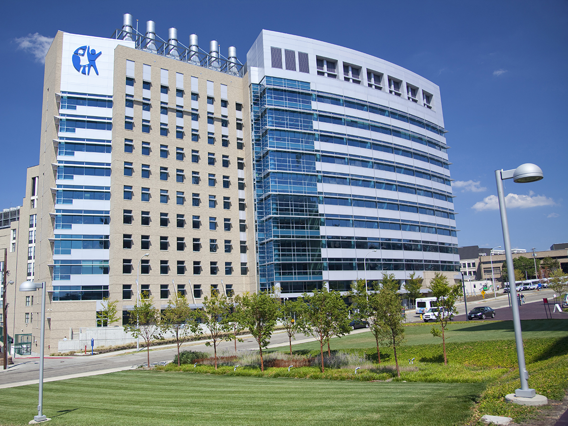
Gathering Participant Input at Cincinnati Children’s
Research Participant Advisory Council (RPAC)
  Started February 2015
  Located at Cincinnati Children’s
  Focused on the overall participant experience at Cincinnati Children’s
West End Community Research Participant Advisory Board
  Started June 2016
  Located at Seven Hills Neighborhood Houses in the West End
  Focused on community health and research

Slide 6
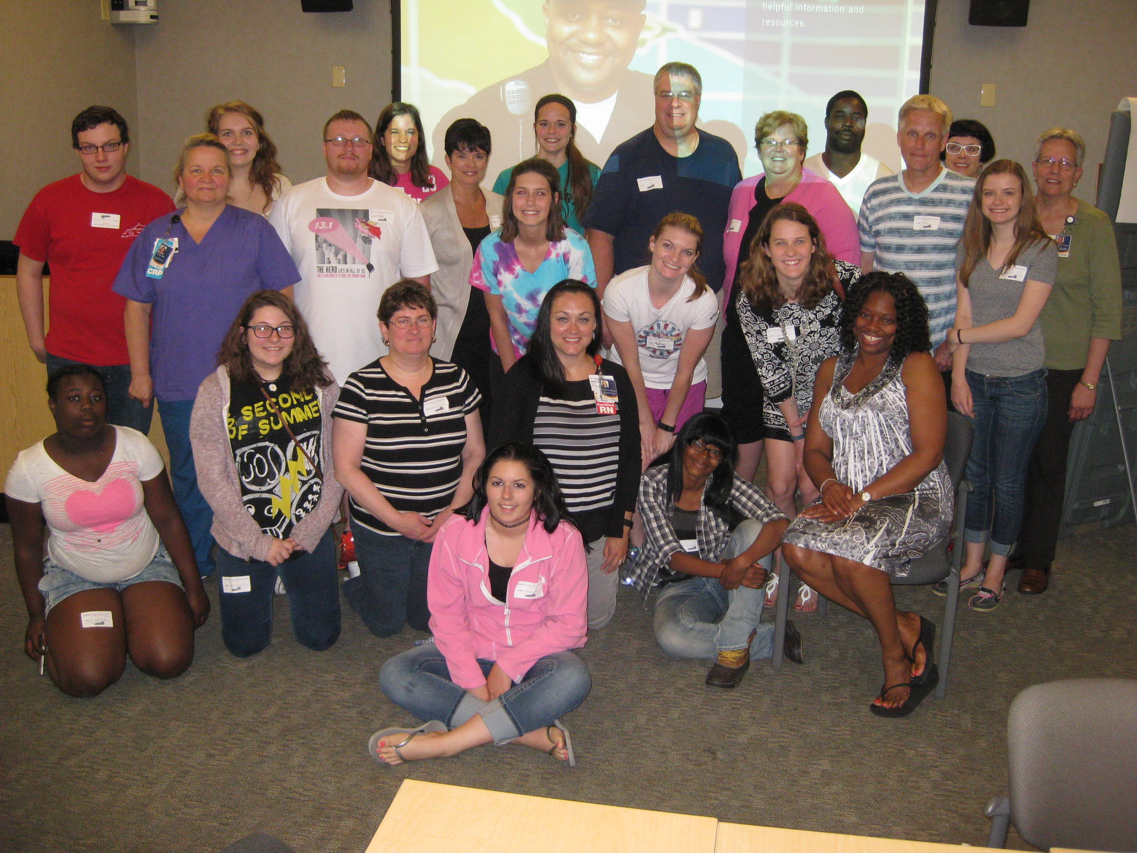
The RPAC at Children’s
Becca Harper, DNP, RN
Part of Doctoral thesis
Saw need for input from research participants, just like receive input from patients at Children’s
Notes:
Becca Harper, Clinical Research Director of Operations over Schubert Research Center and Clinical Translational Research Center (CTRC)

Slide 7
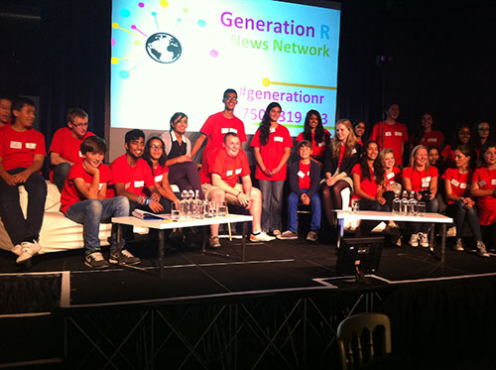


The RPAC at Children’s:
Inspiration for the RPAC
Patient and Family Advisory Council
IACRN Conference Presentation on Generation R:
http://www.youtube.com/watch?v=KvamYWTDwQA&sns=em
Notes:
Beth Moone
Lorraine Hodsdon – Great Ormond Street Children’s Hospital (meet at conference)
Generation R consists of six Young People’s Action Groups (YPAGs), based around England. The YPAGs meet regularly to learn about clinical research and discuss how to make it work better for young people.

Slide 8
The RPAC at Children’s:
The Process
Steering Committee Development
Research
Meet & Greets
CRP Community Support
Recruitment Flyers
Notes:
CRP helped with the recruitment of participants….sent out the call for participants

Slide 9
The RPAC at Children’s:
The Details
RPAC consists of 30 research participants (pediatric and adult) and parents/guardians of research participants.
  ages range from 12-58 years.
10 Staff representatives who act as content experts and group facilitators for focus groups and discussions.
Meet monthly
Onsite at Children’s
Food provided
Transportation vouchers offered

Slide 10
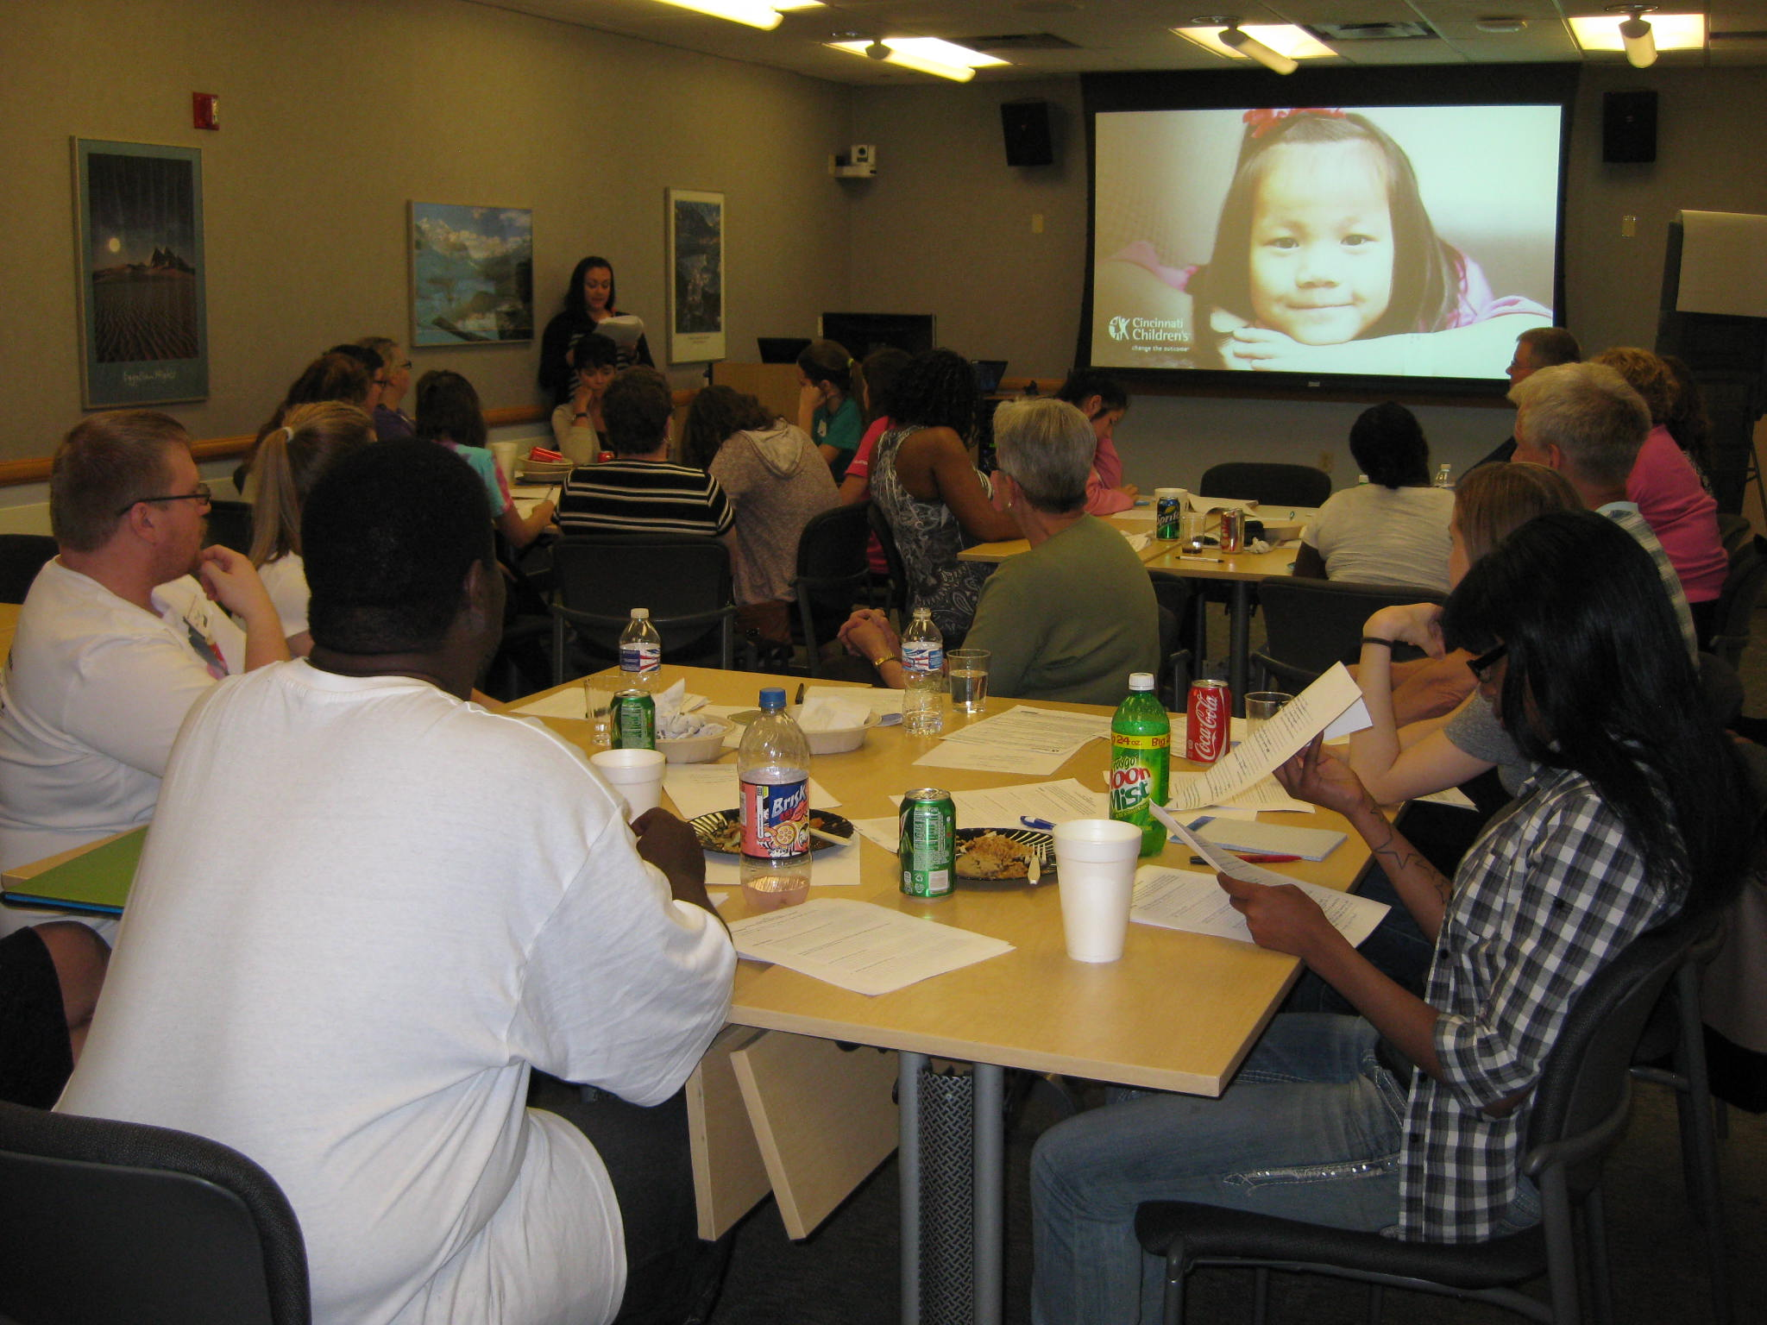
The RPAC at Children’s:
Purpose
The purpose of the Research Participant Advisory Council is to allow for research participants to advise and engage with Cincinnati Children’s Hospital Medical Center (CCHMC) on research and its practices at the medical center.

Slide 11
The RPAC at Children’s:
Objectives
Partner research participants and families with members of the research community to provide guidance on how to improve research across the academic health center, with a focus on participant experiences and building relationships of trust.
Establish best practices and improvement initiatives to implement these changes.
Provide a formal referral system for other patient and family advisory councils across the institution looking to engage in research.
Humanize the face of research at the institution and in the surrounding communities.

Slide 12
The RPAC at Children’s:
Improving Research
  T1 Clinic/Schubert Research clinic design feedback sessions
  Assent Project with College of Design, Architecture, Art, and Planning(DAAP) and Gamble Infectious Disease
  Review of current recruitment material with Research Marketing and Recruitment Core
  Genomics Focus group work with Human Genetics Division
  Review of the Clincard payment process
  Creating a training on research ethics and the research participant experience for potential and current research participants
Notes:
Assent project – To put pictures in the assent documents ( drawings of procedures such as blood draws). Focus group. For all of Gamble.
Genomics – Helped with the study design, genetic report (how the report works), video
Redesigned the look of the genetic report (My Chart) ….results of blood draws in here. Making it easily understood before talking with the doctor.
Helped change the study design (more of a PCORI) Patient Centered Outcomes Research

Slide 13
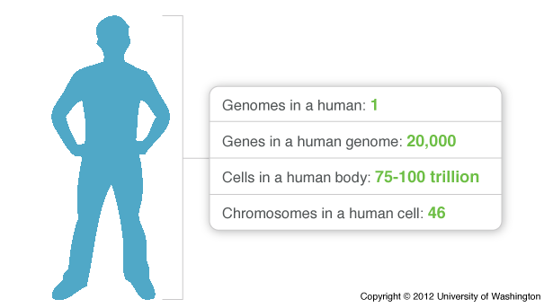
RPAC at Children’s:
Success Story
eMERGE
Human Genetic Focus Group Project

Slide 14
West End Community Research Advisory Board
  Started June 2016
  Located in the West End community at Seven Hills Neighborhood Houses
  Collaboration with Community Researcher Melinda Butsch-Kovacic
  2 meet n’ greets at Seven Hills
  Focused on community health and research

Slide 15

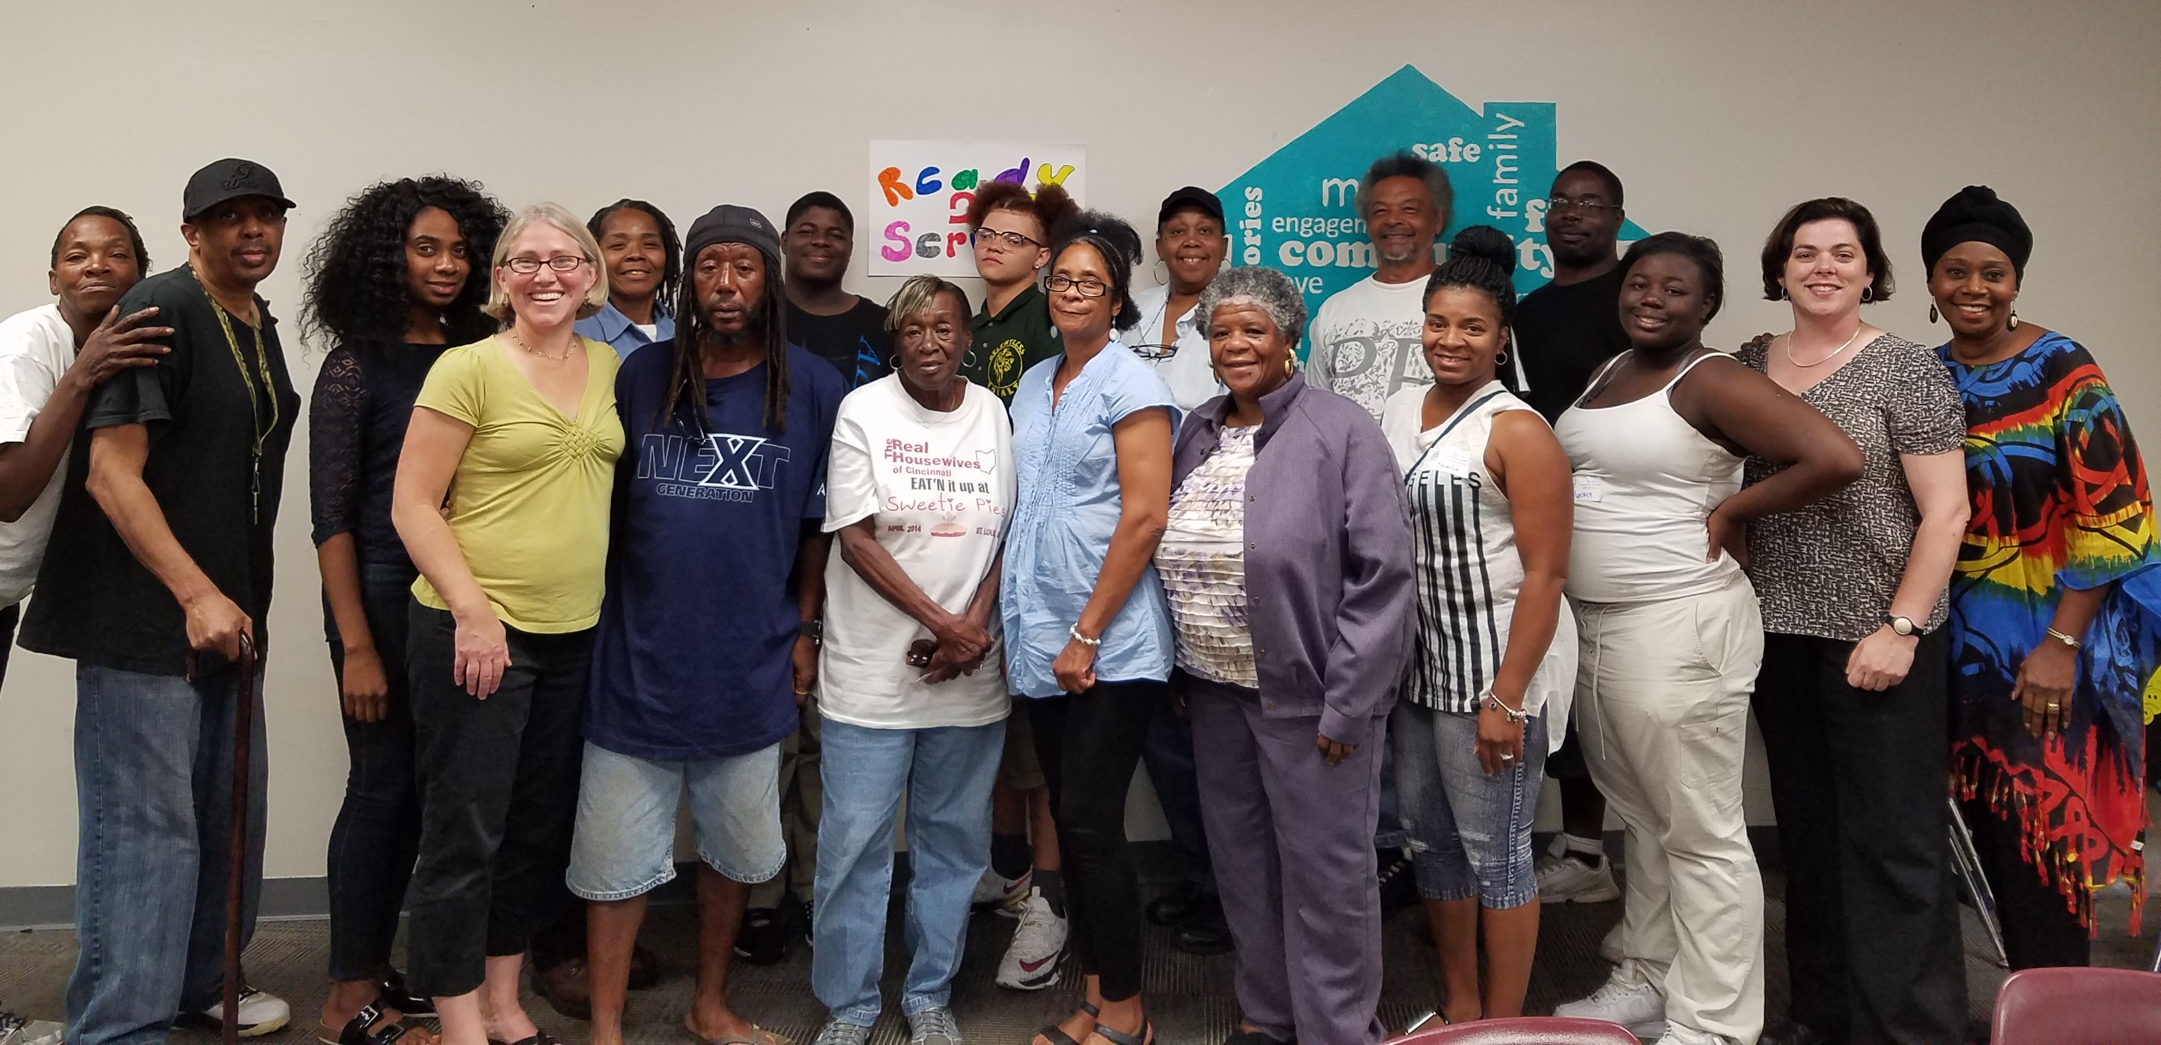
West End Community Research Advisory Board
The purpose of the West End Community Research Advisory Board is to allow for research participants and community members to advise and engage with Cincinnati Children’s Hospital Medical Center (CCHMC) and its researchers on research and its practices in the West End Community

Slide 16
West End Community Research Advisory Board
RPAC consist of 17 West End community members
    ages range from 17-73 years.
2 Staff representatives who act as content experts and group facilitators for focus groups and discussions. One from Children’s and one from Seven Hills.
Meet monthly
Food provided
At Seven Hills
Board Roles: President, Vice President, Secretary, Liaison

Slide 17
West End Community Research Advisory Board: Objectives
Humanize research in the West End community.
Engage researchers to ensure they support the West End’s health goals in addition to collecting study data
Provide opinions on how to make research easier and more understandable for West End community members.
Guide what research happens in the West End.

Slide 18
West End Community Research Advisory Board: Objectives
In Their Own Words….
Why are we here?
Advocate for the West End
Advise and help people with health goals
To help our people/culture better understand the importance of research and find out about how research is done and to learn more about research.
Get to know each other
Learn about the community
Share our voices with researchers

Slide 19
West End Community Research Advisory Board:
In Their Own Words…
In Their Own Words….
What are we trying to accomplish?
Helping people with opportunities for their health and to inform the people
The importance of finding cures through research and to help others. Also to inform others in the community and other areas how being a part of research can enhance research in a major way.
Safe environment & studies
Participants understand research studies

Slide 20
West End Community Research Advisory Board:
In Their Own Words…
In Their Own Words….
Who are we trying to help?
Every member of the community, young and old
Trying to help the research community reach out to others by being there for them to engage with those who seem to be hard to contact and relate to concerning research.
Make research better for the community
Help researchers understand how to invite those in lower-resourced neighborhoods

Slide 21
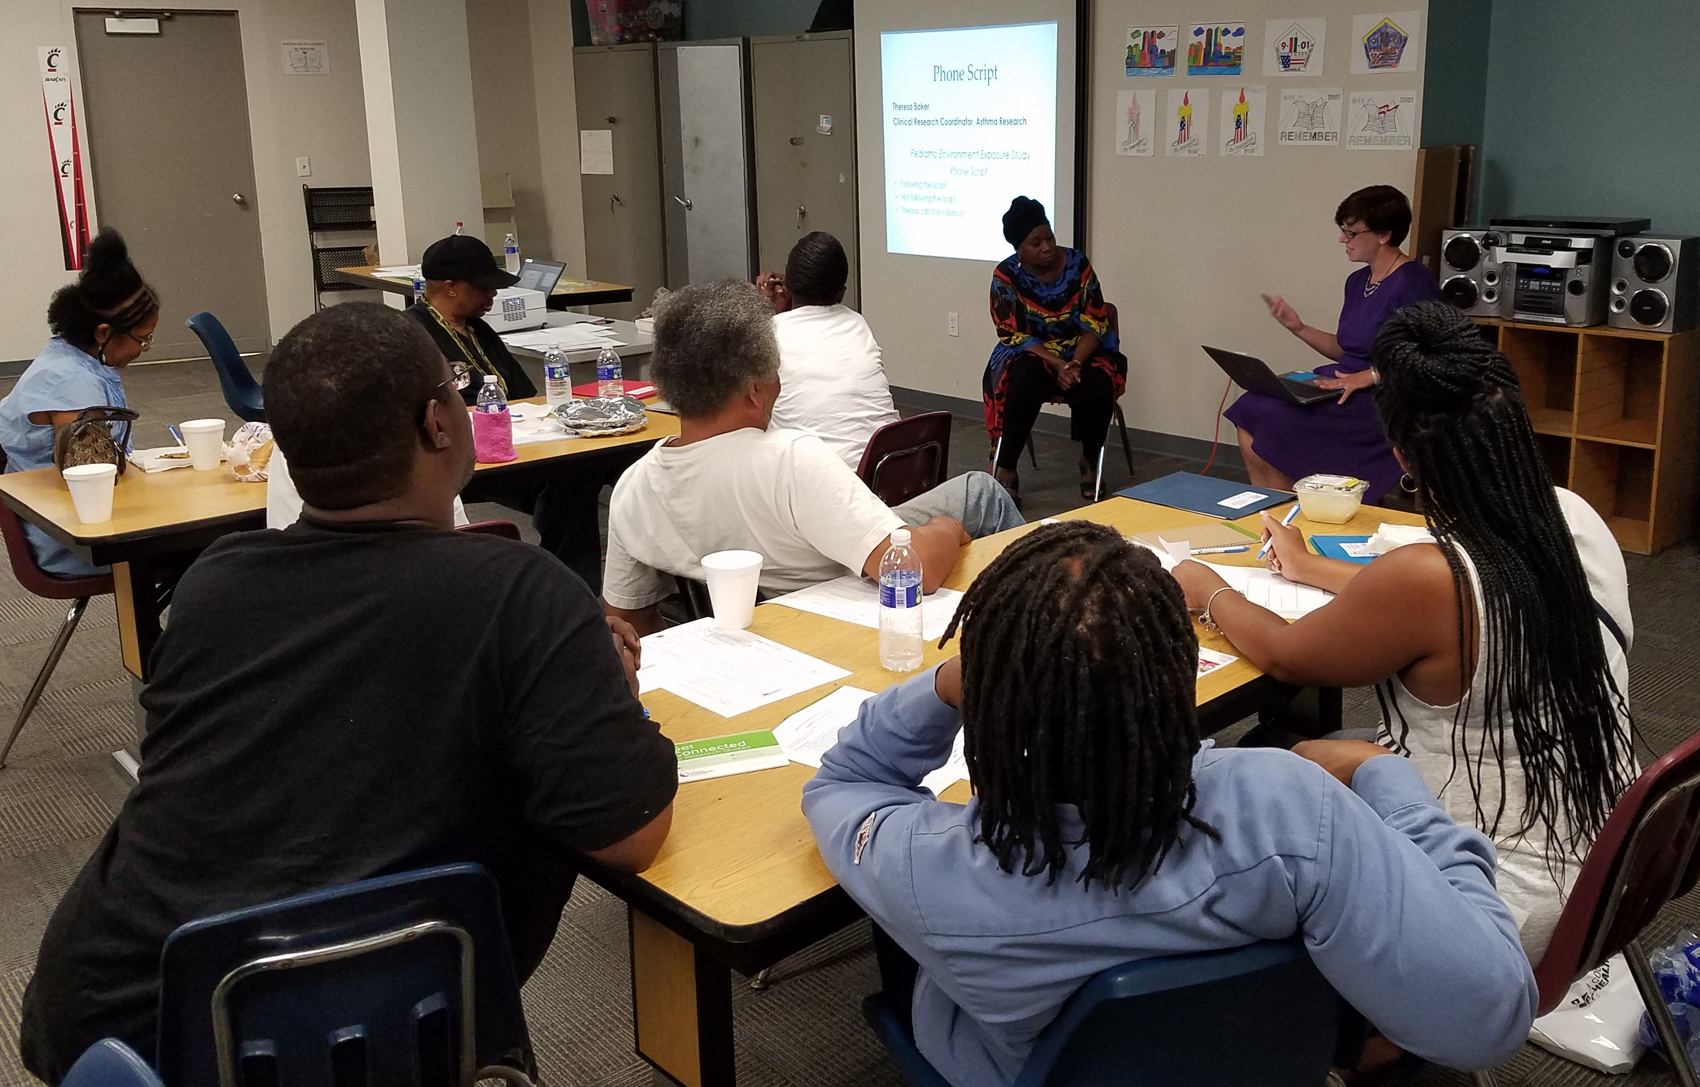
West End Community Research Advisory Board: Projects
  Participating in Research and Reviewing the Recruitment Process
  Survey of the West End Community on Research and Health Needs
  Research Participant Ethics Training

Slide 22
West End Community Research Advisory Board: Community Survey
60 surveys conducted by 9 community researchers
57% female
60% are age 50 or older

Slide 23
West End Community Research Advisory Board: Community Survey
68% Live in the WE
33% Work in the WE
25% Are members of a WE Organization

Slide 24
West End Community Research Advisory Board: Community Survey
70% Have NOT Participated
30% Have Participated

Slide 25
West End Community Research Advisory Board: Community Survey
38% No risks
21% Someone asked

Slide 26
West End Community Research Advisory Board: Community Survey
30% Never been asked
20% No transportation
14% No study relevant to me

Slide 27
West End Community Research Advisory Board: Community Survey
76% Willing
20% Not Willing
3% Maybe

Slide 28
West End Community Research Advisory Board: Community Survey
80% Willing
17% Not Willing
3% Maybe/Depends

Slide 29
West End Community Research Advisory Board: Community Survey
From taking these surveys, who will benefit from it? How will this help the community?
How does your research help the West End?
How will it change the West End?
Not willing to participate unless all data and purpose of study belonged solely to residents.
Are there recorded findings accessible to the "lay" public? Where can this information be found about the different studies?
What would the study be? Will it benefit us all?

Slide 30
West End Community Research Advisory Board: Community Survey
More (research studies) are needed.
Most people don't have any knowledge about what research is doing or what's going on and do without our knowledge. They give us $20 and make multimillions.
Will they be relevant to us? How will we know about them?
Do they pay? Who can we go to about the different studies?
Need to know more information
How do we qualify to participate in research studies?

Slide 31
Research Participant Groups: Next Steps
  Getting the word out:
    Development CCTST Webpage
    Speaking to various groups
    Identifying other places to share the information
  Opportunities for collaboration between groups
  Helping with the development of a UC RPAC
  Development of an RPAC database

Slide 32
The Power of the Participant Perspective
Questions?
Julie Brinker, MPA
Research Community Liaison
Clinical Translation Research Center

