Slide 1
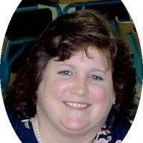
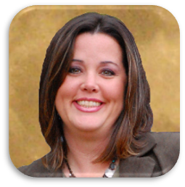
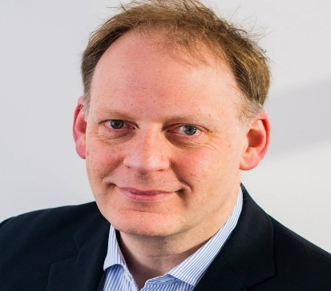
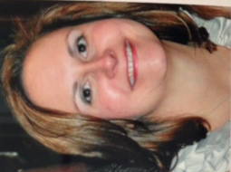
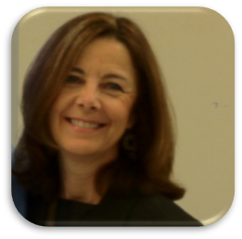
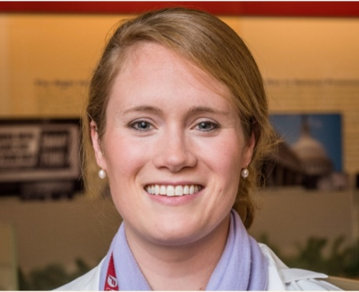
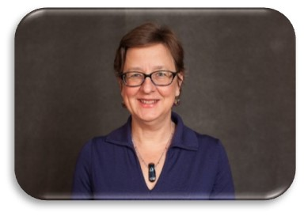
Membership & Marketing Committee
Notes:
Chair: Georgie Cusack, National Heart, Lung and Blood Institute, NIH
Jennifer Allison, NIHR CRF Southampton UK
Laura Baker, Seattle Children’s Research Institute, Seattle, Washington
Candida Barlow, Nurse Consultant
Brian Beardslee, The Dana-Farber Cancer Institute, Boston, Mass
Gordon Hill, Glasgow Caledonian University, UK
Mary Jackson, National Institutes of Allergy and Infectious Diseases, NIH, Bethesda, MD
Terry Jeffs, Georgetown University, Clinical Research Unit, Washington, DC
Catherine Ricciardi, MIT Harvard Catalyst CTSA, Cambridge, Mass
Cameron Sze, The Dana-Farber Cancer Institute, Boston, Mass

Slide 2
Membership & Marketing Committee
Goals
Promote awareness of IACRN
Increase Association membership
Accomplishments
Newly designed website
Reinvigorated In the Loop newsletter
Increased social media awareness

Slide 3
Membership & Marketing Committee
Notes:
Website: hyperlink:
Board of Directors
Leadership Program
Committees
Nomination
Policies
Bylaws
Privacy Policy
Membership-institutional
Chapters
Membership Directory
Renewal
Online Contacts
Education
Toolkit
Publications/Presentations
Webinars
Conference Info
Discussion Board-Job opportunities, In the Loop Issues
In the Loop: hyperlink- highlighted committee members and publications and presentations sent to us over the last year
Twitter-594 in 2016 to 1353 in 2018. Twitter Chat scheduled as we speak
Facebook-698 I 2016 to 1012 I 2018
Linked In-793 in 2016 to 837 in 2018

Slide 4
Membership & Marketing Committee
IACRN membership active and pending: 337
New members in last year-169
Lapsed members: 137
States represented: 31
International: 63
Countries: 21
Continents: 5
Notes:
Continents
Countries
Members
Africa
Egypt
1
Kenya
1
Malawi
4
Nigeria
1
South Africa
3
Tanzania
1
Zambia
1
Asia
China
7
India
2
Indonesia
3
Israel
1
Japan
7
Saudi Arabia
1
Taiwan
3
Australia
Australia
2
New Zealand
1
Europe
Ireland
3
Italy
2
Spain
2
United Kingdom
16
North America
Canada
1

