Slide 1
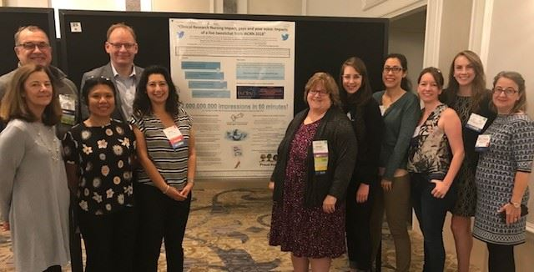
IACRN Membership, Marketing and Communication Committee 2020
Committee Mission
Accomplishments
Members
The MMC supports the mission and vision of IACRN through the management of internal and external communications, membership promotions, and marketing of the organization.
 | 360 Active Members
 | 18 Countries
3 | Australia | 4 | Canada
7 | China | 1 | India
1 | Indonesia | 1 | Ireland
4 | Japan | 1 | Kenya
1 | New Zealand | 1 | Nigeria
1 | Qatar | 3 | South Africa
1 | Spain | 1 | Sweden
2 | Taiwan | 6 | UK
321 | USA | 1 | Zambia
Chair: Terry Jeffs-Georgetown University
Georgie Cusack-National Institutes of Health
Laura Baker, Board Liaison-Seattle
Children's Hospital
Brian Beardslee-Dana Farber Cancer
Institute
Traci Bell-Washington University School of Medicine
Doyle Bosque- MD Anderson Cancer Center
Melody Cayford-Massachusetts General Hospital DRC
Herna Joy Gonzalez-Torrance Memorial Medical Center
Gordon Hill-Glasgow Caledonian University
Allison Hyde-Memorial Sloan Kettering Cancer Center
Janet Moffat-MRN Medical Research Network
Catherine Ricciardi-MIT Clinical Research Center
Dixie Thompson-University of Utah CCTS and TIC
Claire Whitehouse-James Paget University Hospitals NHS Foundation Trust
Impact
Connect with us ~
#IACRN20 and #IACRNLIVE
1813 followers Twitter
1222 follow FB
1158 “Likes” on FB
899 Members on LI
Future Plans
Get Involved
Promote membership & collaboration globally
Secure sponsorships
Develop on-line store
Committee Meetings via Zoom Second Tuesday
of each month
10am-11am EST
Email: M. Terry Jeffs jeffsm@georgetown.edu
Enhancing clinical research quality and safety through specialized nursing practice.

