Slide 1
Marketing Membership, & Communication Committee 2017 Annual Conference Information Session Providence, Rhode Island

Slide 2
Purpose of Membership, Marketing and Communications Committee
Promote awareness of IACRN
Increase Association membership
Disseminate the organization’s initiatives and innovations to the clinical research community

Slide 3
Membership, Marketing and Communications Committee Members
Georgie Cusack, National Heart, Lung and Blood Institute, NIH, Bethesda, MD
Jennifer Allison, NIHR CRF Southampton UK
Laura Baker, Seattle Children’s Research Institute, Seattle, Washington
Brian Beardslee, The Dana-Farber Cancer Institute, Boston, Mass
Amanda Bray, Blood Cancer Network, Ireland (BCNI)

Slide 4
Membership, Marketing and Communications Committee Members
Gordon Hill, Glasgow Caledonian University, UK
Terry Jeffs, Georgetown University, Clinical Research Unit, Washington, DC
Mary Jackson, National Heart, Lung and Blood Institute, NIH, Bethesda, MD
Catherine Ricciardi, Massachusetts Institute of Technology IMES Clinical Research Center, Cambridge, Mass
Cameron Sze, Dana-Farber Cancer Institute, Boston, Mass

Slide 5
Social Media Statistics
• More than half the world uses a smartphone
• Approximately two-thirds of the world’s population has a mobile phone
• More than half of the world’s web traffic now comes from smart phones

Slide 6
SOCIAL MEDIA

Slide 7
Social Media Around the World

Slide 8
Annual Growth of Social Media

Slide 9
Annual Growth of Social Media in Asia Pacific

Slide 10
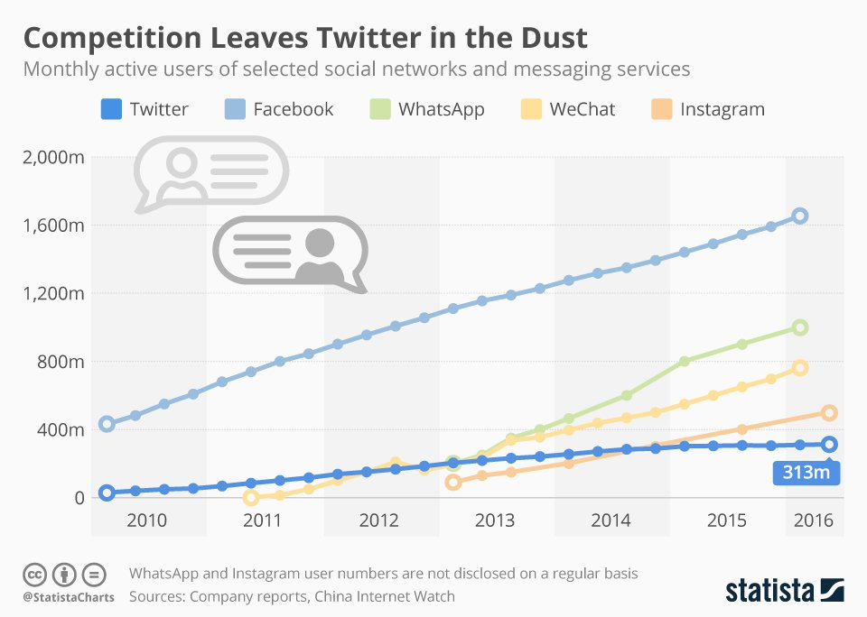
Fastest Growing Social Networks

Slide 11
Social Engagement

Slide 12
Social Media by Demographics

Slide 13
Why is this important for IACRN?
Social medial sites differ by level of usage in different countries and demographics
Understanding differences in usage is important in marketing to your target audience

Slide 14
Where in the world are our members from…
Australia,
Canada,
China,
Ethiopia,
Indonesia
Taiwan Ireland,
Italy,
United Kingdom, Japan
United States Philippines

Slide 15
Membership, Marketing and Communications Committee Social Media Survey
Wednesday, September 20, 2017

Slide 16
92
Total membership as of April 2017 at time survey sent 297 members
Response rate was 31%
Total Responses
Date Created: Friday, April 07, 2017
Complete Responses: 75

Slide 17
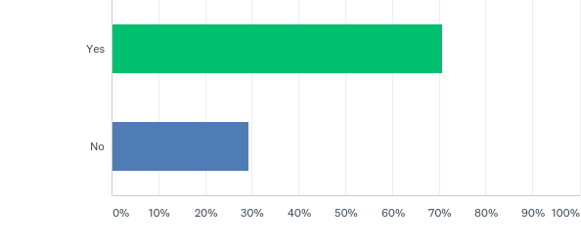
Q1: IACRN has a monthly Newsletter titled "In the Loop". Do you read it?
Answered: 92 Skipped: 0

Slide 18
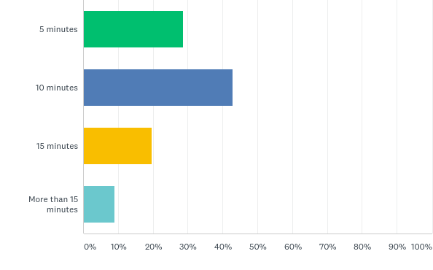
Q2: How long do you spend reading the "In the Loop" Newsletter?
Answered: 56 Skipped: 36

Slide 19
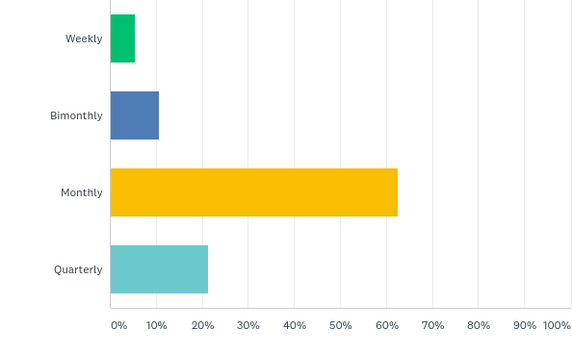
Q3: How often would you like to receive "In the Loop" Newsletter updates?
Answered: 56 Skipped: 36

Slide 20
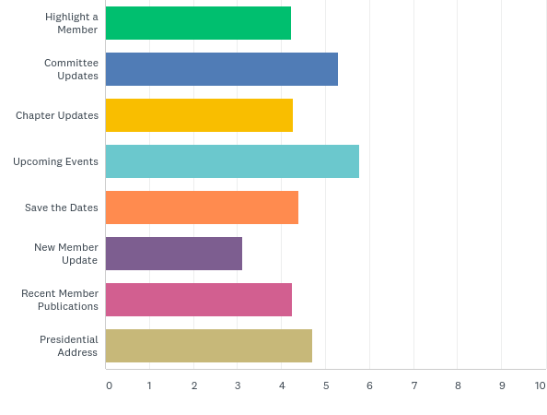
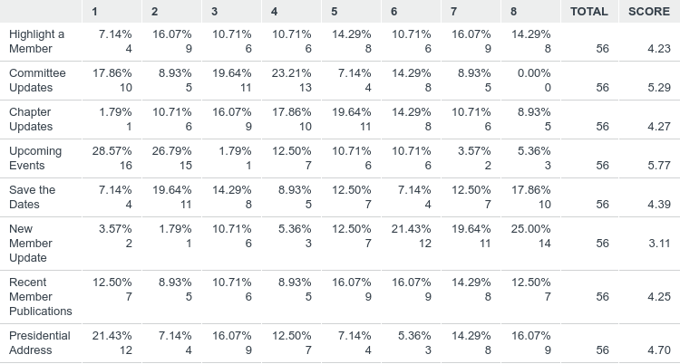
Q4: Please rank the current list of topics that are included in the "In the Loop" Newsletter from most important to least important.
Answered: 56 Skipped: 36

Slide 21
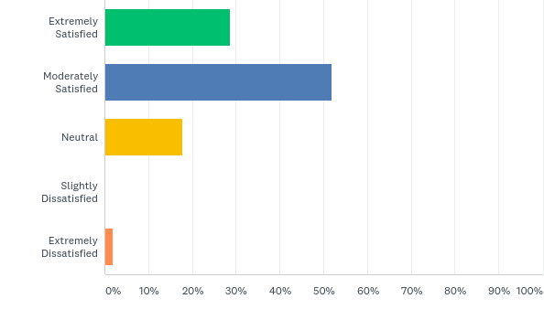
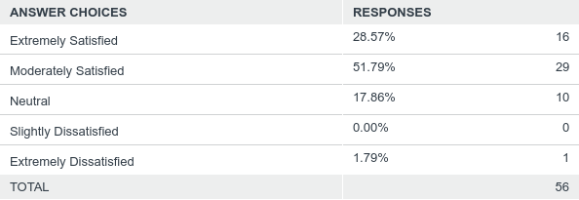
Q5: What is your overall satisfaction with "In the Loop" Newsletter
Answered: 56 Skipped: 36

Slide 22
QUESTION 6: Fill In…. What topics would you like to see included “In the Loop” Newsletter?
Tips or resource section
Best practices
Ethical issues
Networking opportunities
Feature member articles
Legislative updates
Upcoming conferences

Slide 23
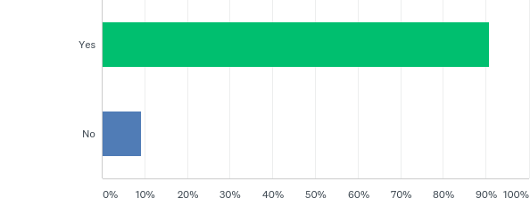
Q7: IACRN has a website. Do you access the website?
Answered: 76 Skipped: 16

Slide 24
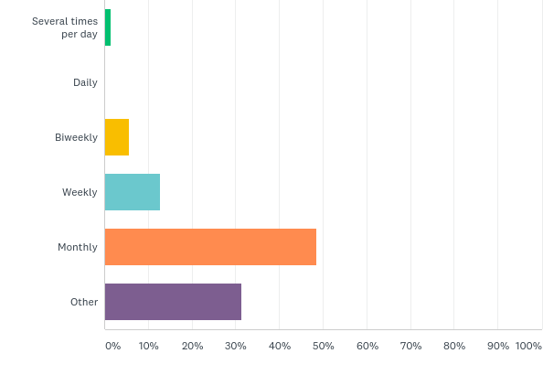
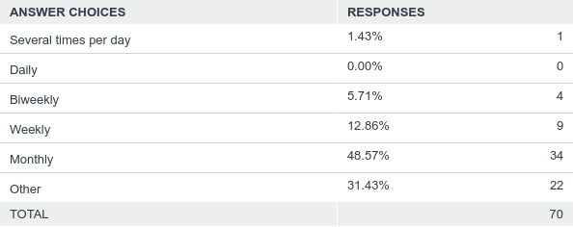
Q8: How often do you access the IACRN website?
Answered: 70 Skipped: 22

Slide 25
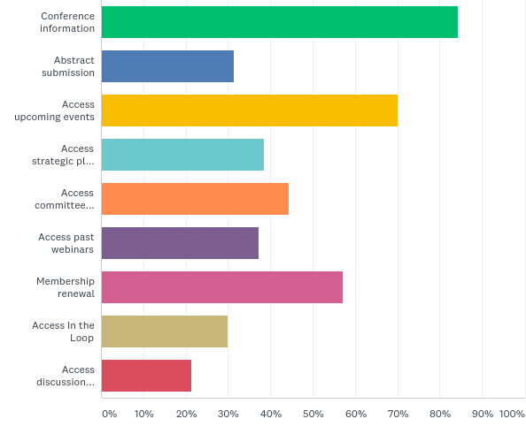
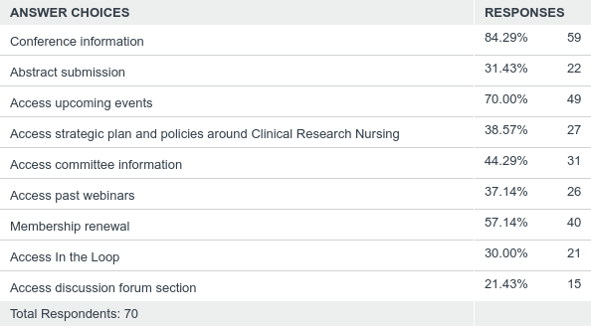
Q9: Why do you access the IACRN website? Check all that apply
Answered: 70 Skipped: 22

Slide 26
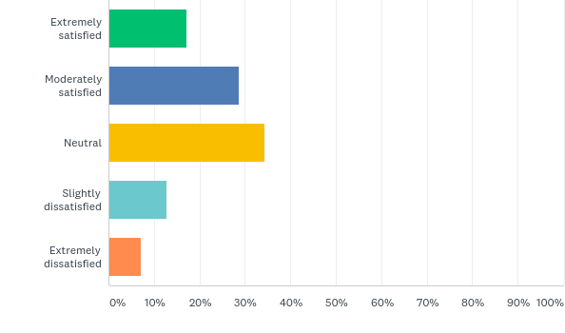
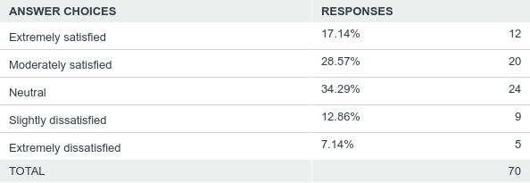
Q10: What is your overall satisfaction with the IACRN website?
Answered: 70 Skipped: 22

Slide 27
Website Satisfaction Comments
Too Static
Difficult to navigate
Out of date
Limited Content
Not professional
Does not highlight work of organization

Slide 28
Q11. What features would you like to have added to the IACRN website?
Membership search
Discussion forums
More professional
Past conference locations
Past webinars
Membership contributions
Directory, tools and information library

Slide 29
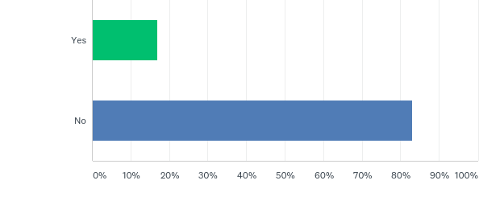
Q12: IACRN has a Facebook page. Do you access the IACRN Facebook page as a communication tool?
Answered: 77 Skipped: 15

Slide 30
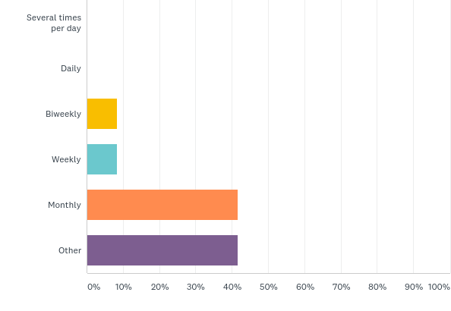
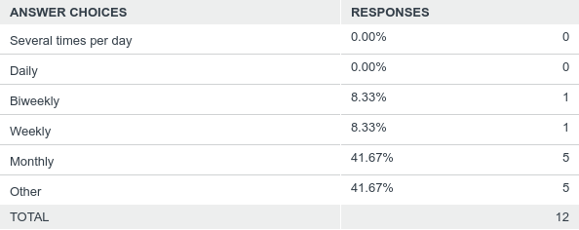
Q13: How often do you access the IACRN Facebook page?
Answered: 12 Skipped: 80

Slide 31
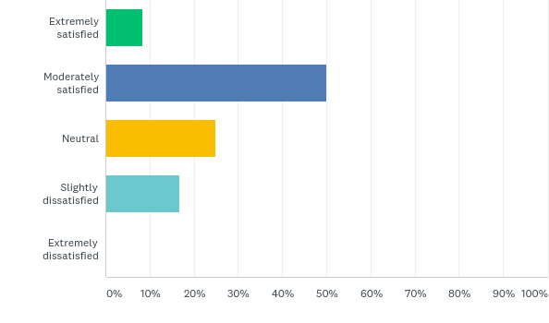
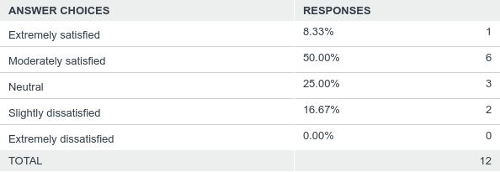
Q14: What is your overall satisfaction with the IACRN Facebook page?
Answered: 12 Skipped: 80

Slide 32
Q15. What information would you like to see posted on the IACRN Facebook account?
Member events
More photos of members
Resource section
Current events

Slide 33
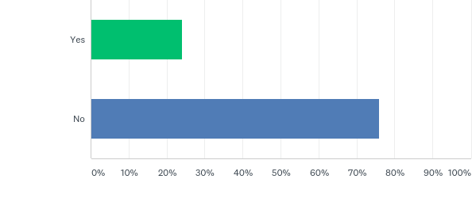
Q16: IACRN has a Linked In account. Do you access the Linked In account as a communication tool?
Answered: 75 Skipped: 17

Slide 34
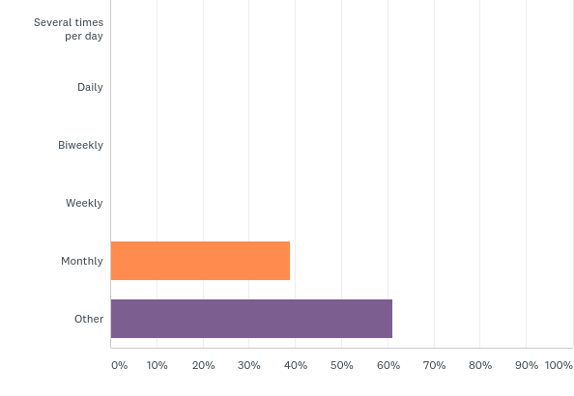
Q17: How often do you access the IACRN Linked In account?
Answered: 18 Skipped: 74

Slide 35
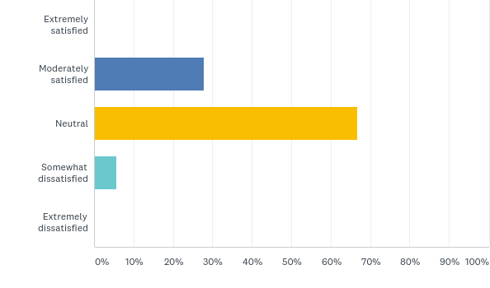
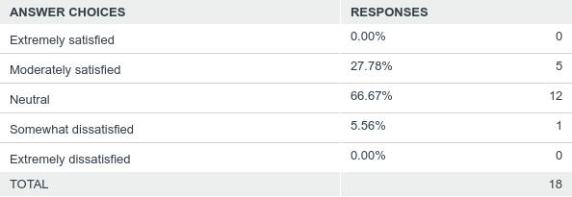
Q18: What is your overall satisfaction with the IACRN Linked In account?
Answered: 18 Skipped: 74

Slide 36
Q19. What information would you like to see posted on the IACRN LinkedIn account?
Job postings
Publications related to Clinical Research
Nursing

Slide 37
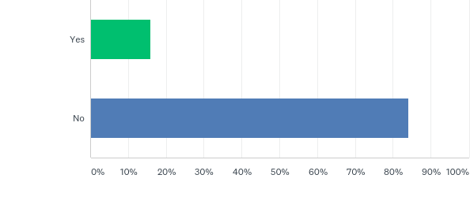
Q20: IACRN conducts twitter chats. Have you participated in one of the twitter chats?
Answered: 75 Skipped: 17

Slide 38
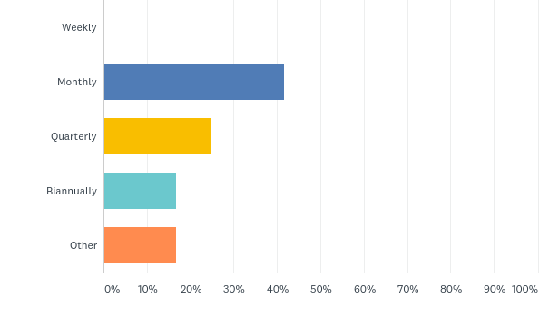
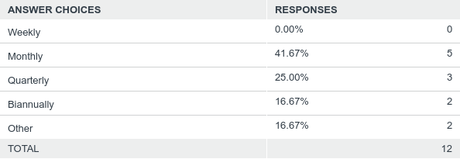
Q21: How often should the IACRN conduct a twitter chat?
Answered: 12 Skipped: 80

Slide 39
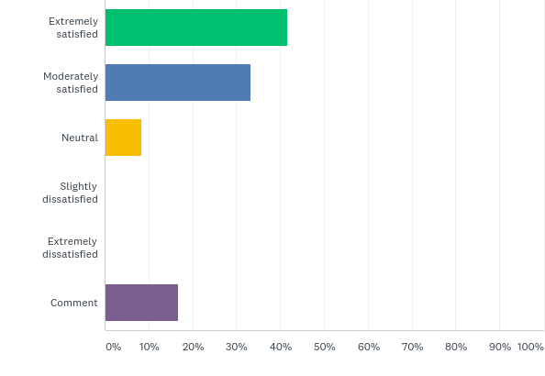
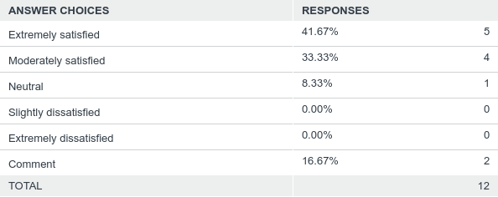
Q22: What is your overall satisfaction with the IACRN twitter chats?
Answered: 12 Skipped: 80

Slide 40
Feedback from our members is vital…
What type of marketing items would be of interest to you…
Tote Bag
Travel Mugs
Insulated Lunch Bag
Coffee Mug
Pens
Hat
T-Shirt
Logo Patches
Pins
Other; please specify

Slide 41
Research Nurses Making a Difference: International Association of Clinical Research Nurses
https://www.youtube.com/watch?v=vIMIRU7IcwM&feature=youtu.be
Chapter resource from Ohio Valley IACRN

Slide 42
IACRN Website https://cameronksze.wixsite.com/mysite-1

Slide 43
Your feedback is important to us

Slide 44
GET INVOLVED…
Committees:
Chapter Governance
Education
Membership, Marketing, Communications
Nominations
Research
Scope and Standards

Slide 45
Your involvement helps us grow strong!
Thank you.

